Slide 1
Visual Queries
Dr. Neil H. Schwartz

Slide 2
Visualization: Defined
Visualization refer to the 2D and 3D static and animated visual displays that depict conditions, situations, processes, places or events as they appear in maps, diagrams, graphs, pictures, schematics, data-based spatial or linear renditions, and immersive virtual environments
Active Vision: Thinking about graphics and graphic design as cognitive tools.

Slide 3
Assumptions Underlying Visualization
Visualization is an active and constructive process.
It is comprised of products and processes.
Visualization products are: graphics and the visuospatial layout of graphic designs
Visualization products are best conceived as cognitive tools.
Visualization processes activate the pattern processing sections of the brain.
Pattern processing mean to see a Gestalt entity that is meaningful to the viewer.
Visualization is exceedingly fast– milliseconds
Visualization is shared between internal and external referents.

Slide 4
Visual Processing: Basic Ideas
Visual processing is based on the idea of “just enough” processing.
Salient visual stimuli are sampled
Visual processing is based on “just-in-time processing.
Only important stimuli are processed, but only at the moment you need them.
Just-in-time & just-enough processing is provided by rapid scanning–-- eye movements within 100 milliseconds.
Visual processing requires attention: “We are conscious of the field of information to which we have rapid access rather than being immediately conscious of the world.”

Slide 5
Visual Processing: It’s All about attention
Visual thinking consists of a series of acts of attention, driving eye movements and tuning the brain’s pattern-finding circuits.
These acts of attention are called:
visual queries

Slide 6
Visual Processing: Just enough-just in time
Long term Store
Working Memory
Sensory Buffer
External Environment

Slide 7
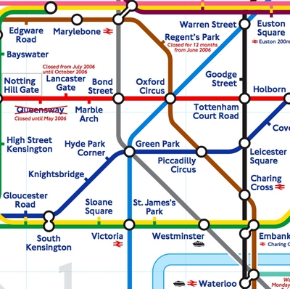
More about visual queries
Visual queries are problem based.
Consider the following image:

Slide 8
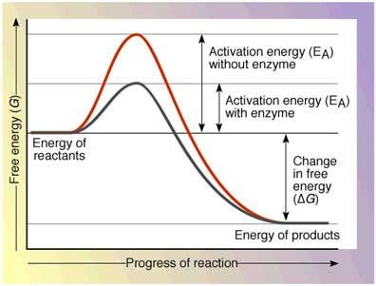
More about visual queries
Visual queries are problem based.
Consider this image:

Slide 9
More about visual queries
Visual queries are problem based.
Finally, consider this image:

Slide 10
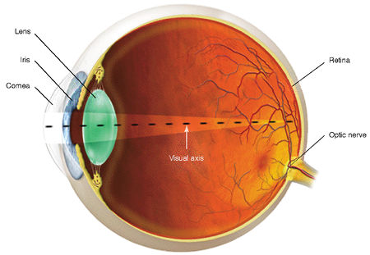
The Eye & the visual System
There are two cell types on the retina that detect light.
Rods: Three types.
Cones: One type.

Slide 11
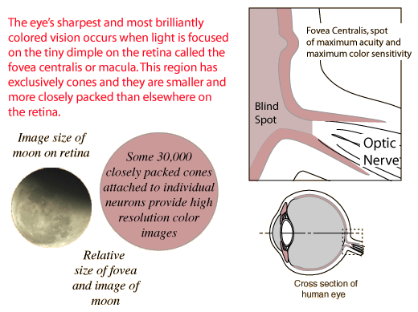
The Eye & the visual System
Mucula – 2.5 – 3.0 mm
Fovea Centralis – 0.3 mm at the center
15 degree angle
Densely packed cones
No Rods

Slide 12
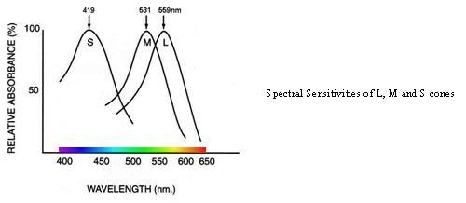
cones
Cones detect color
6-7 million
Concentrated in the central yellow spot known as: “macula”
The types of cones are:
L Cones– absorb wavelengths at 559 nm.
M Cones- absorb wavelengths at 531 nm.
S Cones- absorb wavelengths at 419 nm.

Slide 13
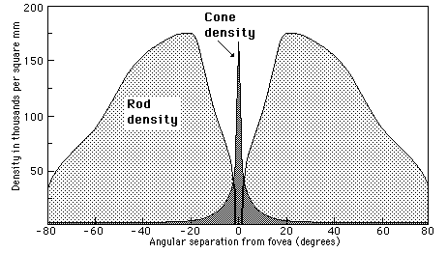
rods
Detect movement
Color insensitive
Approximately 120 million

Slide 14
“The non uniformity of our visual processing power reveals that half of our visual brain is directed to processing less than 5% of the visual world…. That is why we have to move our eyes.”
In short, we do not comprehend the world all at once.
It just seems that way.

Slide 15
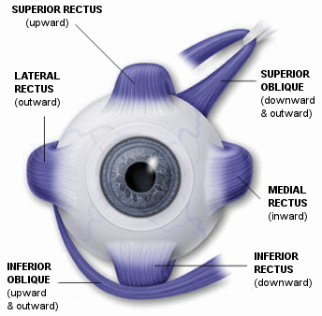
Muscles of the Eye
Responsible for focusing target stimuli on the fovea.
Accelerate to an angular velocity of 900 degrees per second.
Can stop in less than 1/10 of a second.
Movement-stop-movement is termed a “saccade”.
During a saccade, vision is suppressed.

Slide 16
Visual Perception: Two Processes
Top Down
Driven by demands of attention.
Bottom Up
Driven by the visual information in the pattern of light falling on the retina.
Attention is driven by the needs of the task.

Slide 17
Visual Perception: top down - bottom up

Slide 18
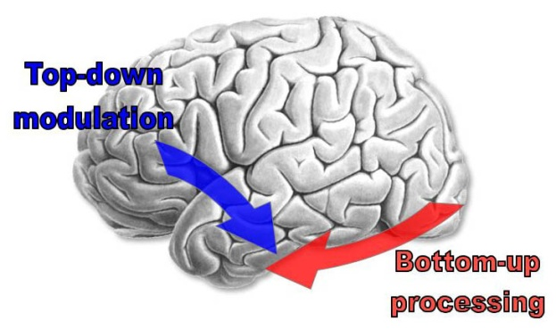
Visual Perception: How it works Bottom UP
Feature Detection
Pattern Segmentation
Pattern Comprehension

Slide 19
Visual Perception: Bottom-UP
More neurons (90%) devoted to feature processing--5 billion neurons form a parallel processing system to operate on information from one million fibers in the optic nerve.
Feature detection pulls out:
Size & orientation
Red-green & yellow-blue differences
Motion and depth
Pattern recognition parses visual information into regions of texture and color.
Pattern comprehension occurs by comparing in visual working memory to previously-known shapes & object in the long-term store.

Slide 20
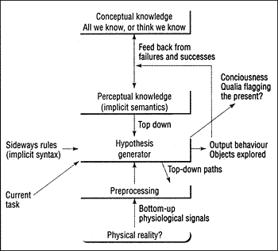
Visual Perception: How it works Bottom-Up top-Down

